Slide 1
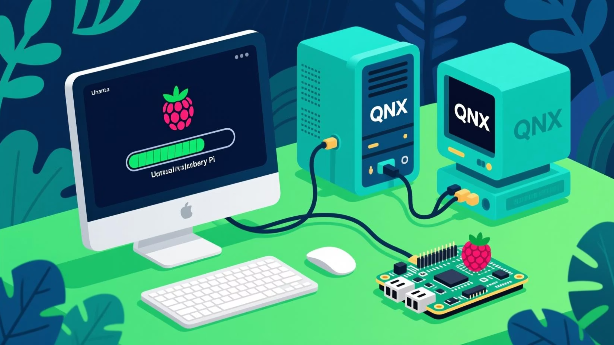
QNX-Raspberry pi FOTA

Slide 2
System Overview
Raspberry Pi: OTA Client
Initiates update requests
1
Receives update metadata
Downloads and applies updates
QNX System: OTA Server
Serves as decision authority
2
Responds to client requests
Provides version and update metadata
This architecture clearly defines the roles and responsibilities, ensuring a secure and controlled update process for embedded systems.

Slide 3
Hardware and Software Setup
Client Hardware & OS
Client Application
The client operates on a Raspberry Pi 4, leveraging a custom-built Yocto Linux image for optimized performance and a streamlined OS footprint.
The client application is developed with Qt6, featuring a responsive QML UI for user interaction and a robust C++ backend handling core logic and OTA update processes.
Server Environment
Network Connectivity
The OTA server component runs on the QNX OS (SDP 8), securely hosted within a virtual machine to ensure isolated and stable operations for critical services.
Communication between the client (Raspberry Pi) and the server (QNX VM) is established via a reliable Ethernet/IP network, ensuring efficient data transfer for updates.

Slide 4
Client Application Architecture
1
Qt6 QML UI
Modern, responsive, and intuitive user interface
2
OtaController Bridge
Exposes APIs (Q_PROPERTY, Q_INVOKABLE) for seamless UI-backend communication
3
C++ Backend
Handles core logic, robust functionality, and isolates business logic from UI
4
Communication
Secure communication protocols and efficient file reception for OTA updates

Slide 5
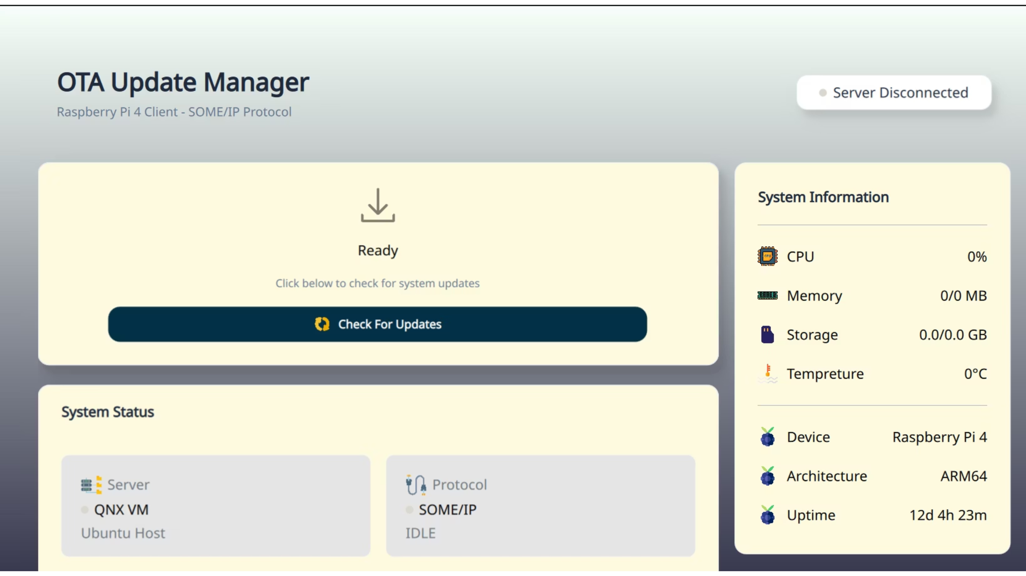

Slide 6
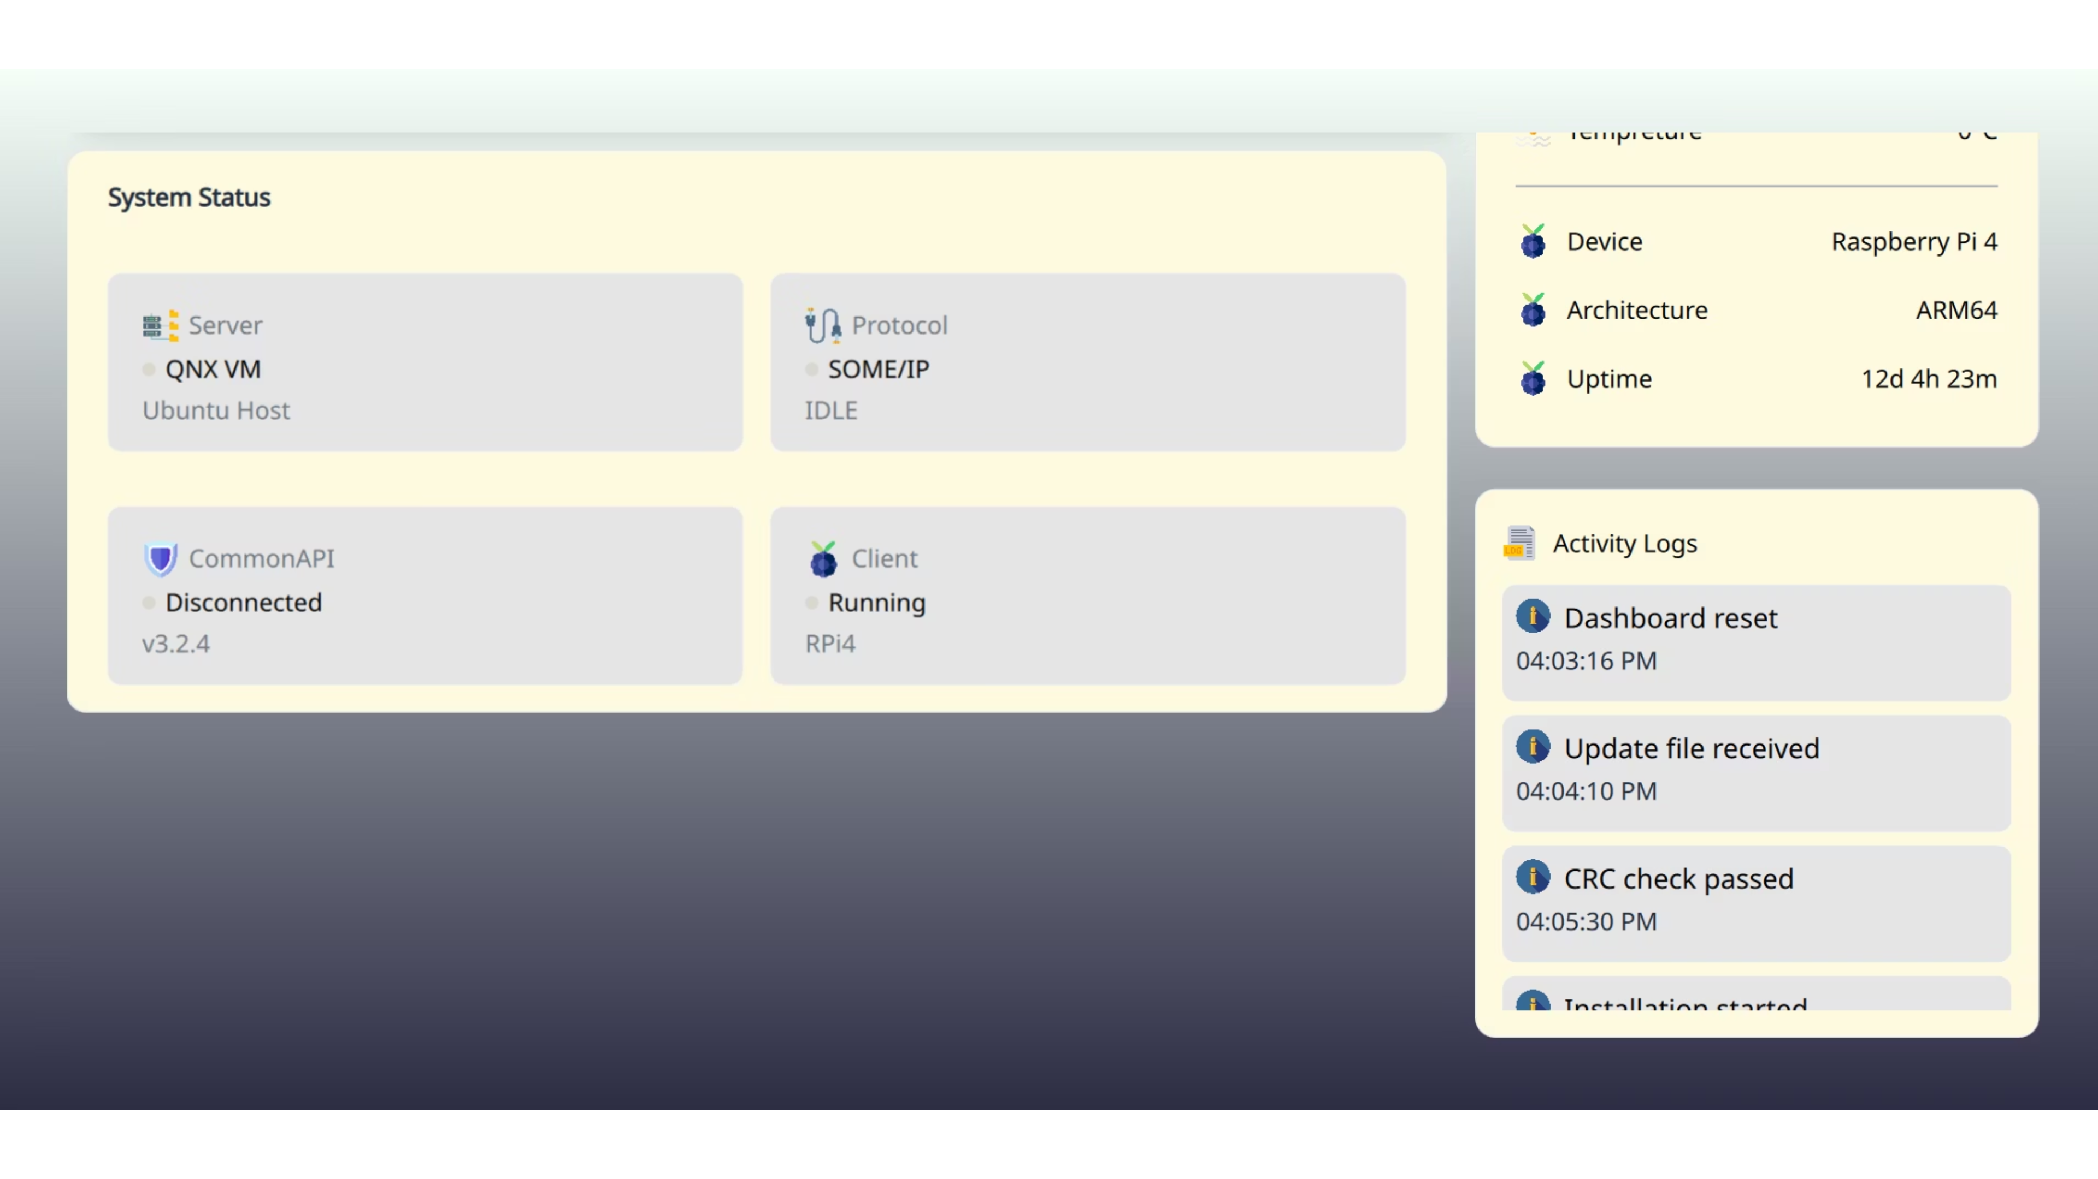

Slide 7
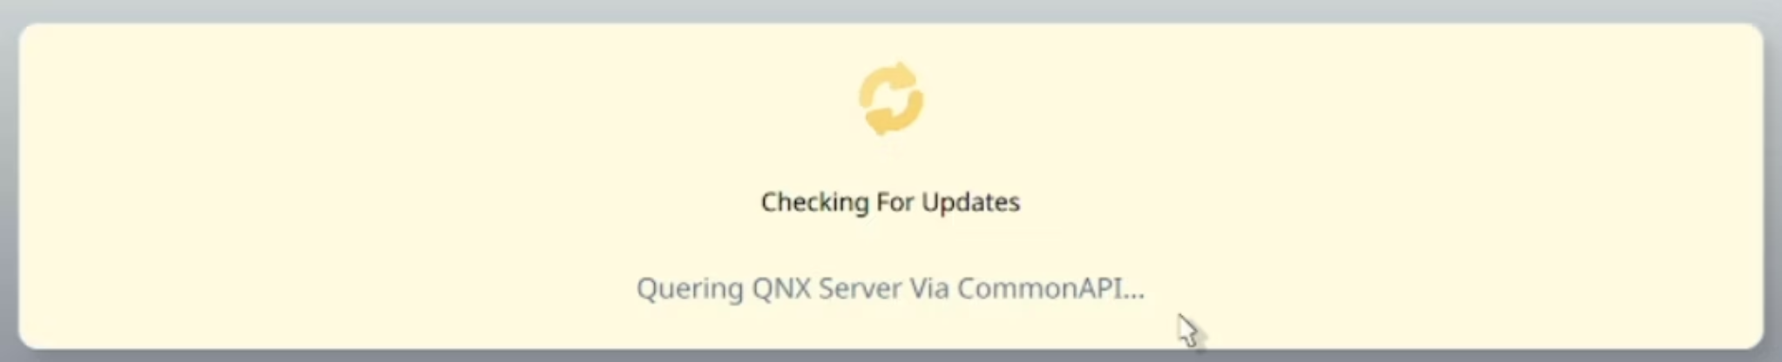
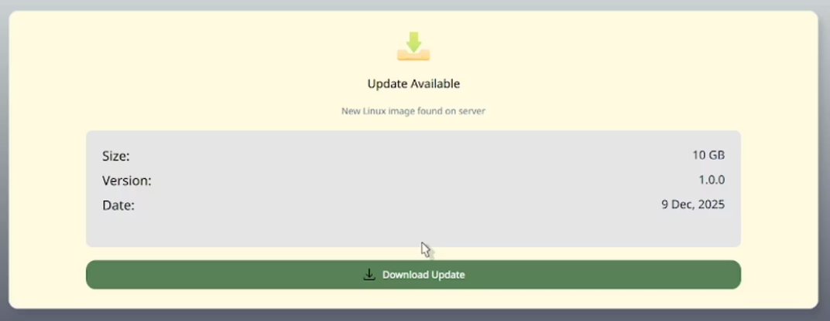
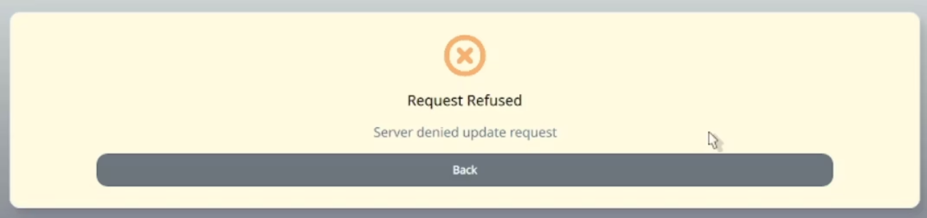
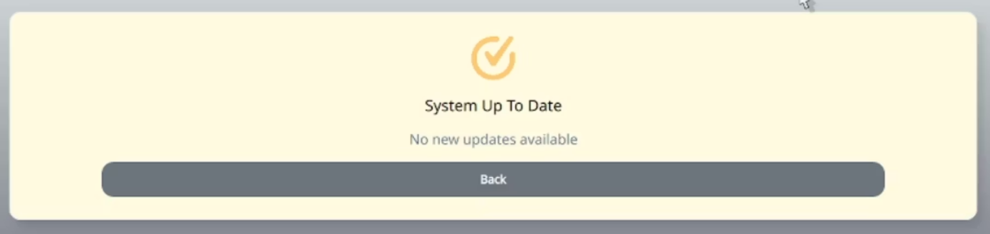
Client UI Cards

Slide 8
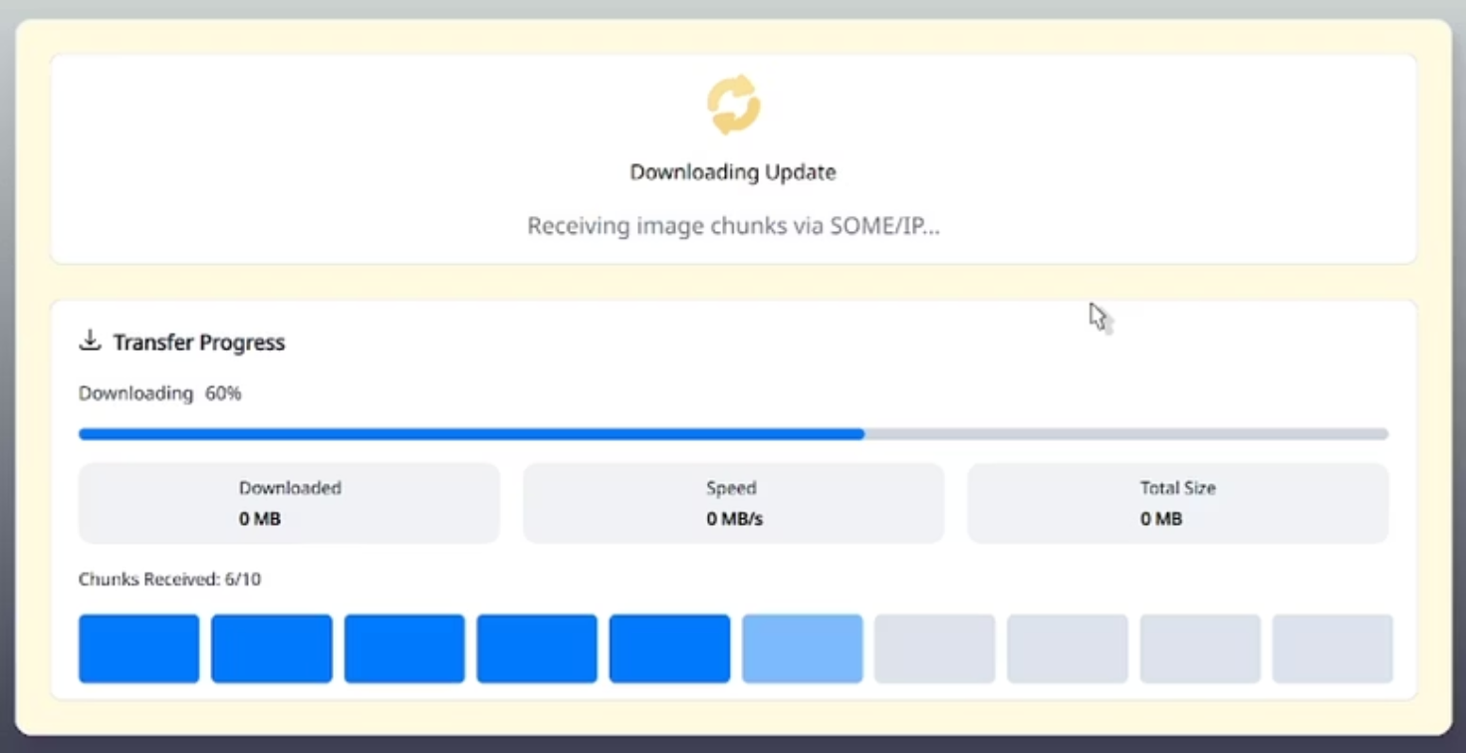
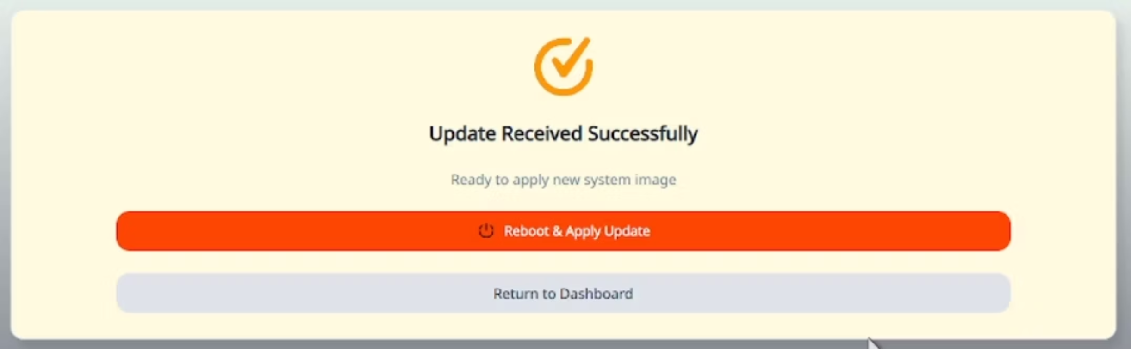
Client UI Cards

Slide 9

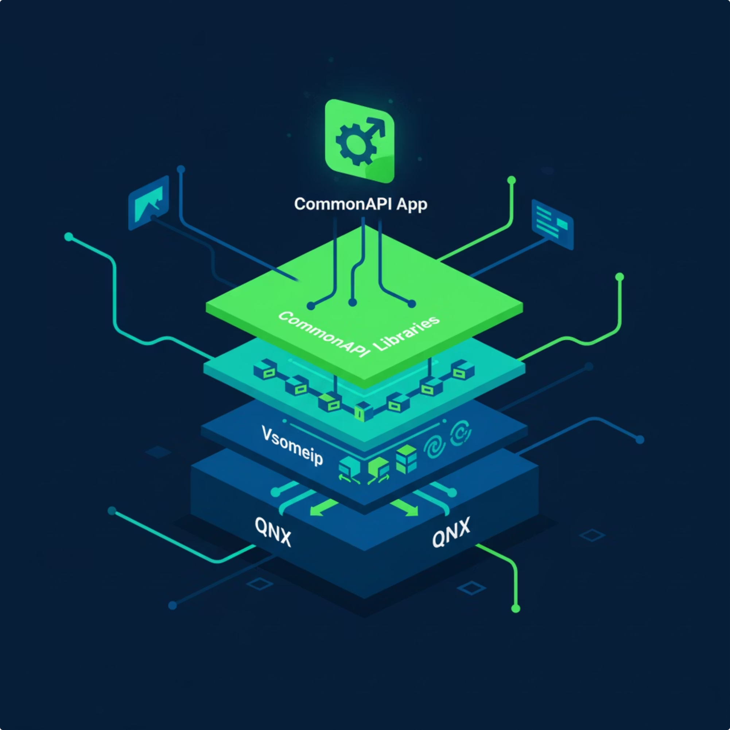
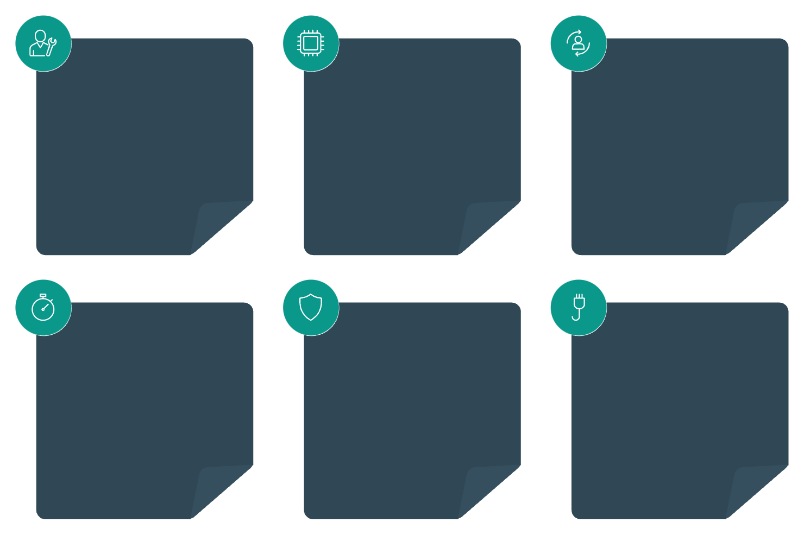

Server Application Architecture
CommonAPI Service
QNX Platform
IPC Integration
Implemented as a CommonAPI service
Runs on QNX real-time OS
Inter-process communication using CommonAPI
Deterministic Behavior
Safety-Critical
Networked APIs
Real-time predictable responses
Designed for safety and reliability
Supports service discovery and transport

Slide 10





Communication Stack
Our system employs a robust, layered communication stack to ensure reliable and efficient data exchange between components. This architecture ensures clear separation of concerns and optimized performance.
CommonAPI App
1
High-level RPC Abstraction
2
CommonAPI Runtime
Standardized service interface
3
SOME/IP Binding
Protocol-specific implementation
4
vsomeip Library
SOME/IP runtime, service discovery
5
Network Layer
Ethernet/IP for data transfer
CommonAPI is utilized for remote procedure call (RPC) abstraction, providing a consistent API for service interaction. Below this, vsomeip acts as the SOME/IP runtime, handling service discovery and efficient messaging. This layered approach allows for both control (RPC) and high-volume data transfer (events).

Slide 11
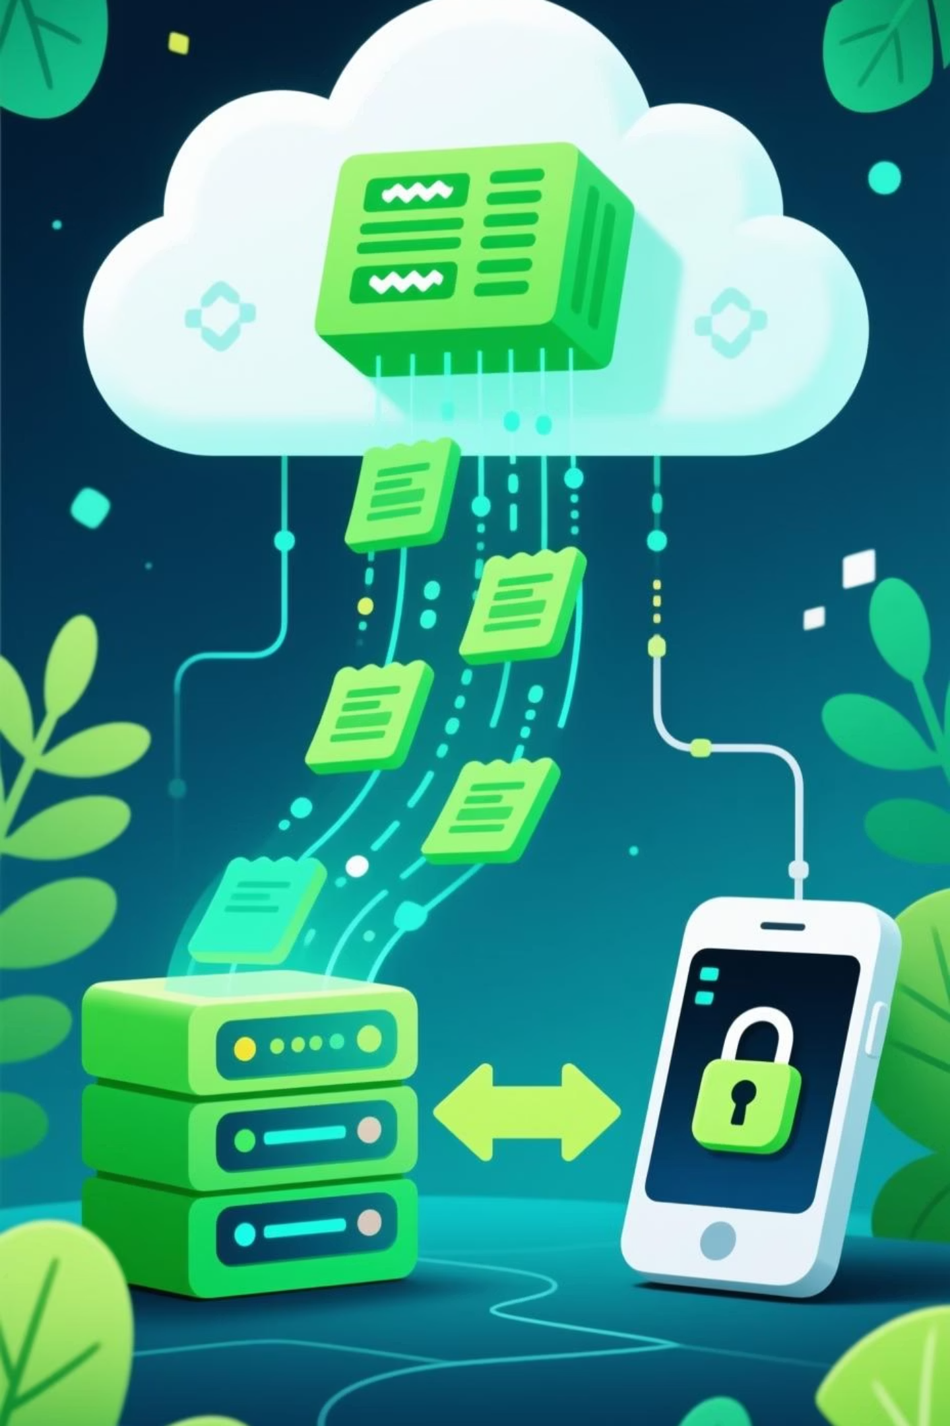

OTA Update Sequence
01
Server Availability Check
The client initiates contact to confirm the OTA server is online and ready.
02
Client Version Request
The client sends its current software version to the server.
03
Server Compares Versions
The server cross-references the client's version with available updates.
04
Update Download Initiation
If a new version is identified, the client proceeds to download the update package securely.
For a detailed visual representation, please refer to the external sequence diagram.

Slide 12
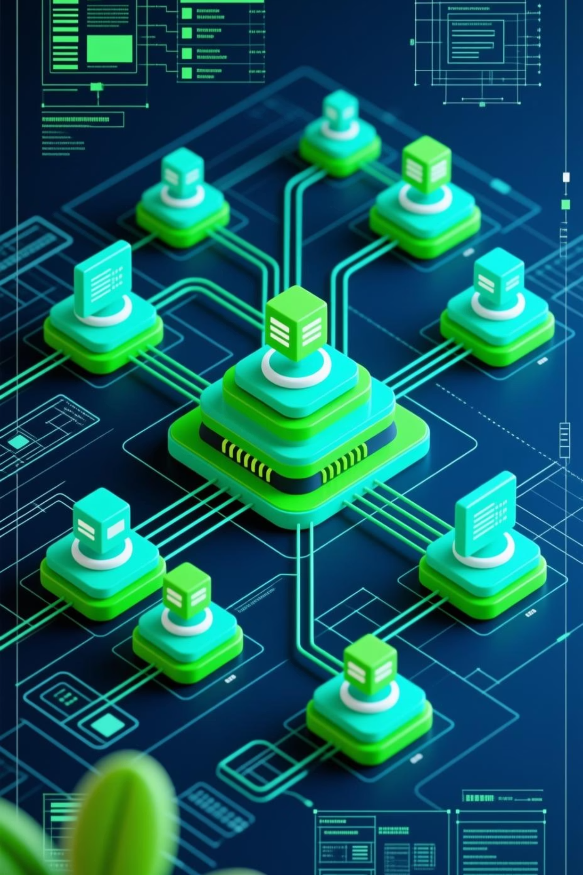

System Architecture Diagrams
Deployment Diagram
Visualizes the physical deployment of software artifacts on the network and hardware nodes, illustrating where components run.
Component Diagram
Highlights the structure of the system by showing its software components, their interfaces, and dependencies.
Class Diagram
Details the system's static structure, representing classes, attributes, operations, and relationships between them.
For an in-depth understanding of the system's structural and behavioral aspects, these comprehensive diagrams are available.
Detailed architecture diagrams are presented in a separate PDF for clarity.

Slide 13

Questions?
We welcome your inquiries and are ready to delve deeper into any aspect of our QNX-Raspberry Pi FOTA solution. Let's discuss!

Slide 14
Thank You!

